Slide 1
Glucose… Where Does it Come From:
Photosynthesis
Moretz
Biology, 2018

Slide 2
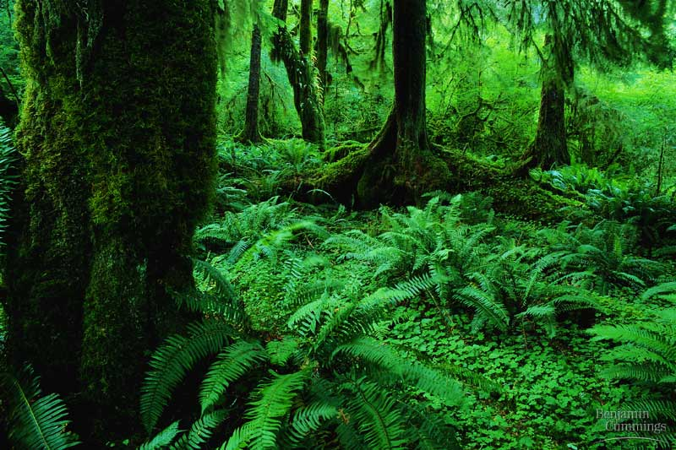

Slide 3
Outline
Purpose of photosynthesis
Overview of photosynthesis
Light dependent reaction
Light independent reaction

Slide 4
Importance of Energy
Living organisms need energy to do everything.
  Move
  Grow
  Reproduce
  Maintain homeostasis
Photosynthesis & respiration are needed for living organisms to get energy.

Slide 5
How do plants meet their energy needs?
Remember, science is a process…..
…..a brief history lesson is in order

Slide 6
The process of understanding photosynthesis
Until almost 350 years ago, plants were thought to feed on soil
  Jan Baptista van Helmont
  Planted willow tree in pot
  Allowed tree to grow for 5 years
  Compared weight of tree and soil to original weight
  Tree gained 74kg, soil lost 57g

Slide 7
The process of understanding photosynthesis
100 yrs later we learned that plants release oxygen into the atmosphere
  Joseph Priestly
  Candles “damaged” air
  Sprigs of mint “restored” air

Slide 8
The process of understanding photosynthesis
Finally, ~1800 Jan Ingenhousz determined:
  Air was “restored” only in the presence of sunlight
  Only by a plant’s green leaves, not by it roots
  But, he suggested that the source of the oxygen was CO₂

Slide 9
Photosynthesis vs. Respiration
Photosynthesis- turns energy into sugars
Respiration- turns sugars into energy
Photosynthesis
Energy
Sugars
Respiration

Slide 10
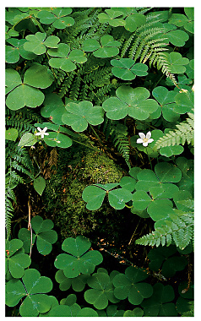
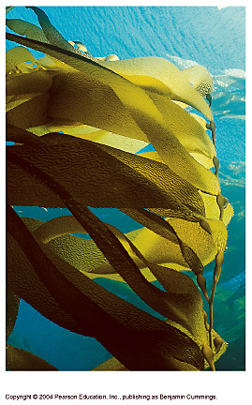
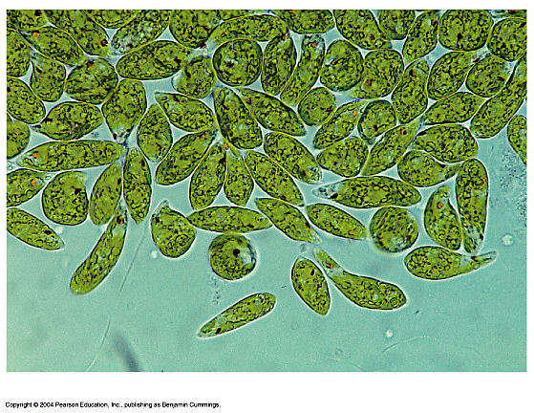
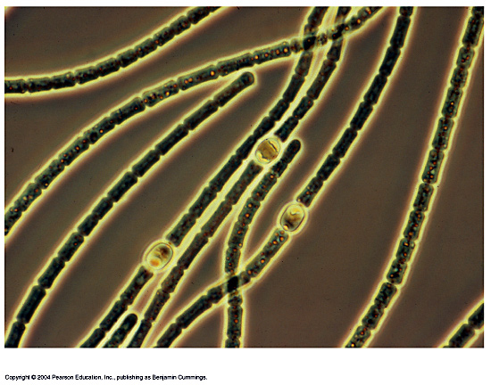
THE BASICS OF PHOTOSYNTHESIS
Almost all plants are photosynthetic autotrophs, as are some bacteria and protists.
  Autotrophs generate their own organic matter through photosynthesis
  Sunlight energy is transformed to energy stored in the form of chemical bonds
(c) Euglena
(d) Cyanobacteria
(a) Mosses, ferns, and
flowering plants
(b) Kelp

Slide 11
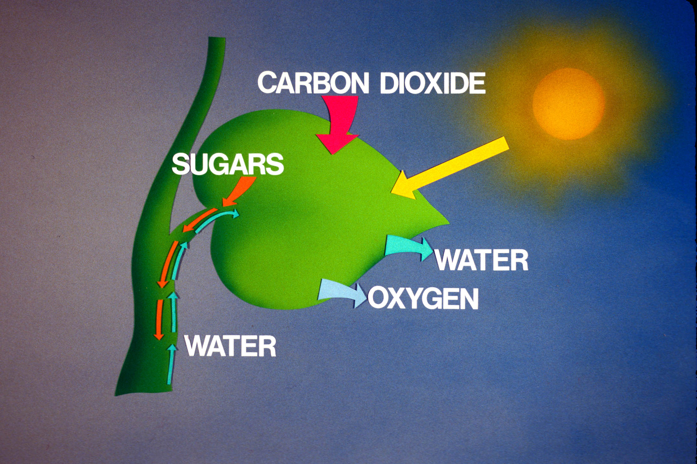
Light Energy Harvested by Plants & Other Photosynthetic Autotrophs
6 CO₂ + 6 H₂O + light energy → C₆H₁₂O₆ + 6 O₂

Slide 12
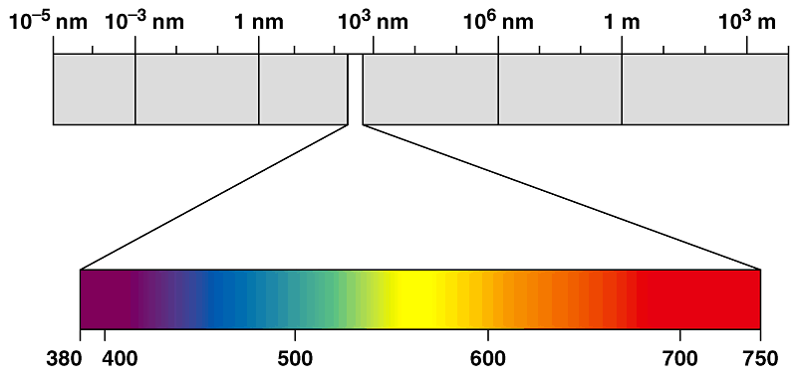
WHY ARE PLANTS GREEN?
Different wavelengths of visible light are seen by the human eye as different colors.
Gamma
rays
X-rays
UV
Infrared
Micro-
waves
Radio
waves
Visible light
Wavelength (nm)

Slide 13
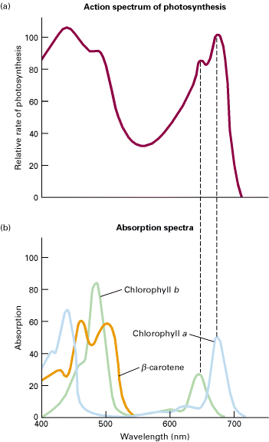
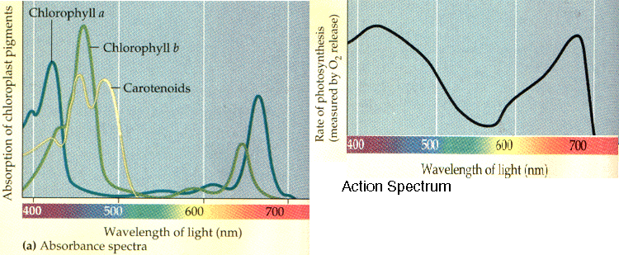
Different pigments absorb light differently

Slide 14
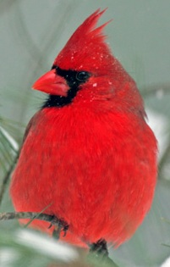
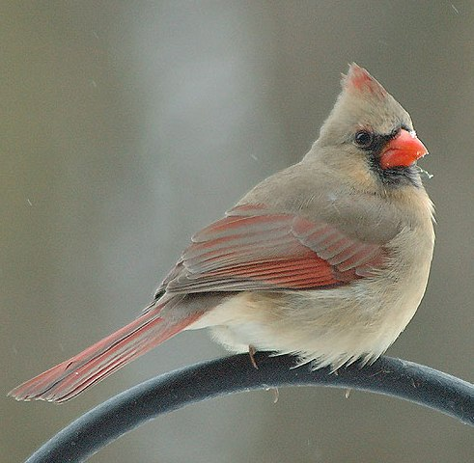
The feathers of male cardinals are loaded with carotenoid pigments. These pigments absorb some wavelengths of light and reflect others.
Reflected light
Sunlight minus absorbed wavelengths or colors equals the apparent color of an object.

Slide 15
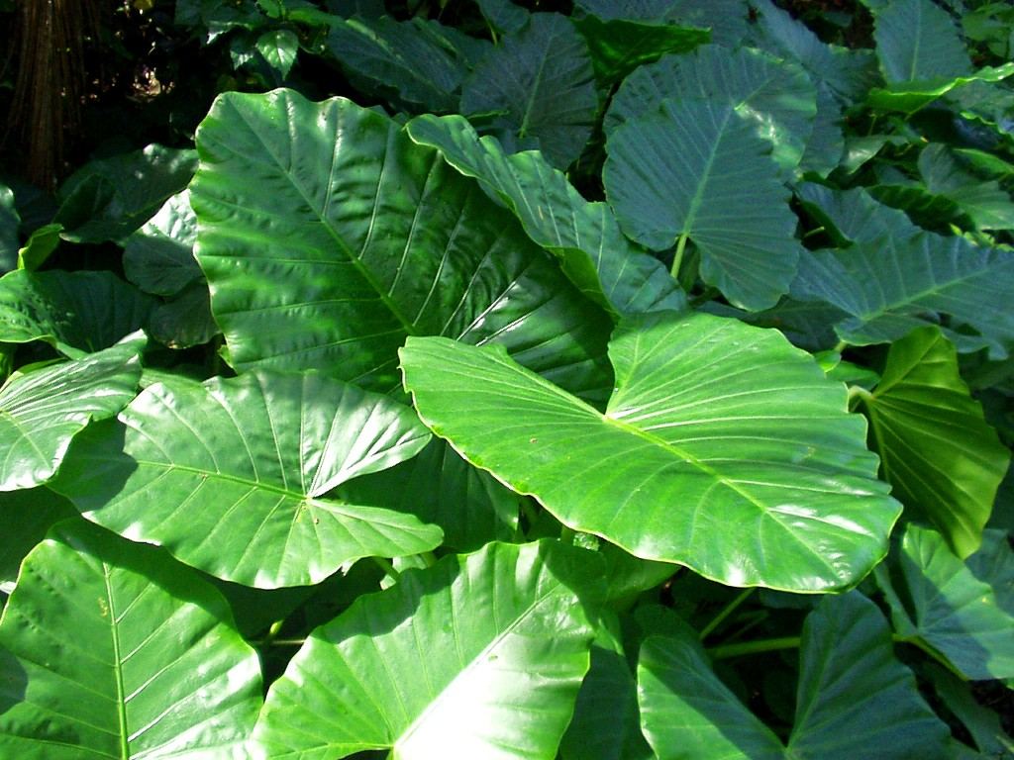
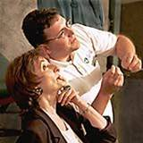
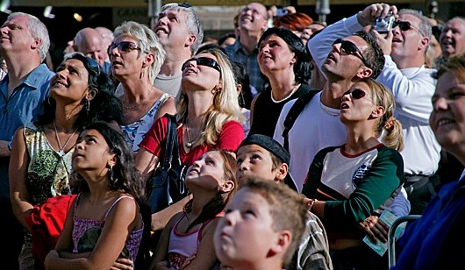
Why are plants green?
Reflected light
Transmitted light

Slide 16
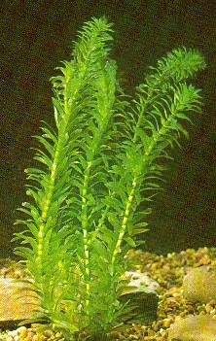
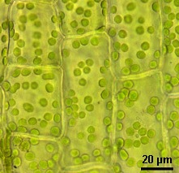
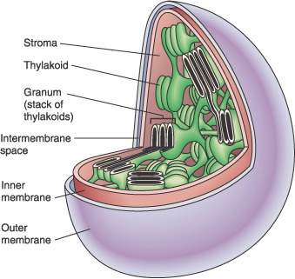
WHY ARE PLANTS GREEN?
Plant Cells have Green Chloroplasts

Slide 17
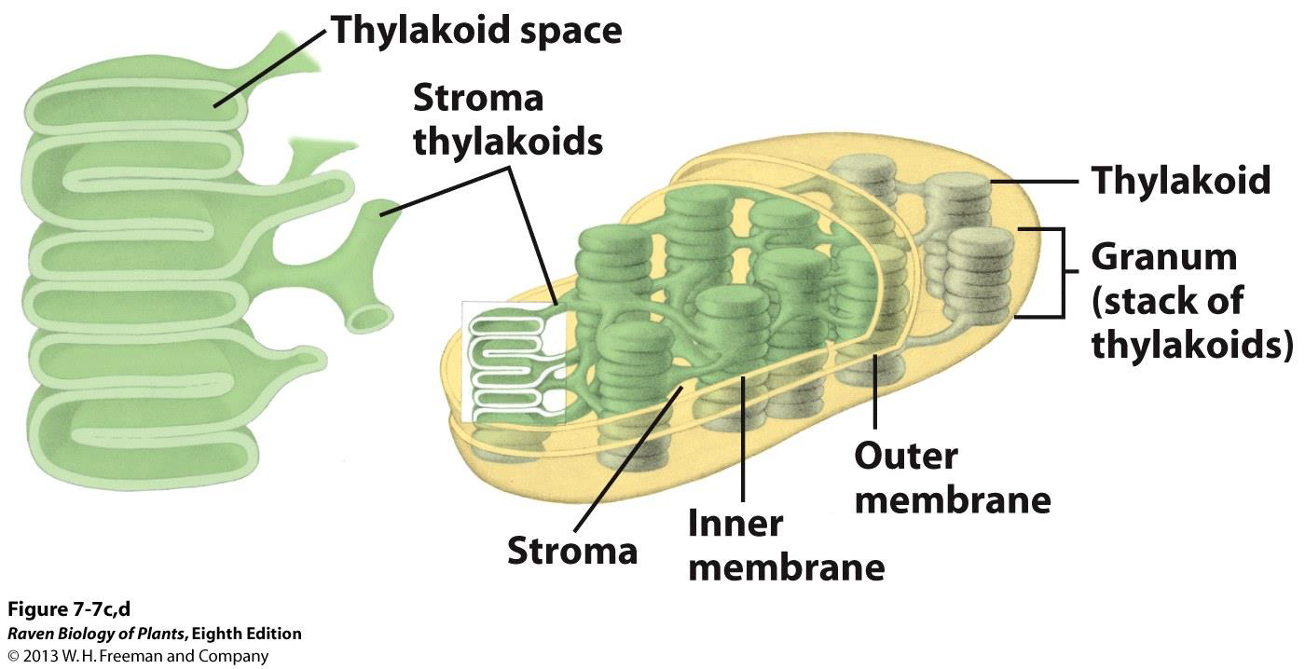
Structure of a Chloroplast
The thylakoid membrane of the chloroplast contains pigments (i.e., chlorophylls, carotenoids).

Slide 18
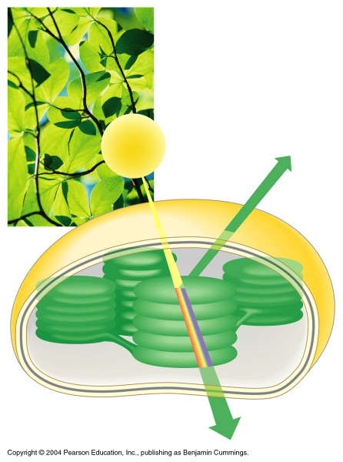
THE COLOR OF LIGHT SEEN IS THE COLOR NOT ABSORBED
Chloroplasts absorb light energy and convert it to glucose
Reflected
light
Light
Absorbed
light
Transmitted
light
Chloroplast

Slide 19
Photosynthesis occurs in chloroplasts
In most plants, photosynthesis occurs primarily in the leaves, in the chloroplasts
A chloroplast contains:
  stroma, a fluid
  grana, stacks of thylakoids
The thylakoids contain chlorophyll
  Chlorophyll is the green pigment that captures light for photosynthesis

Slide 20
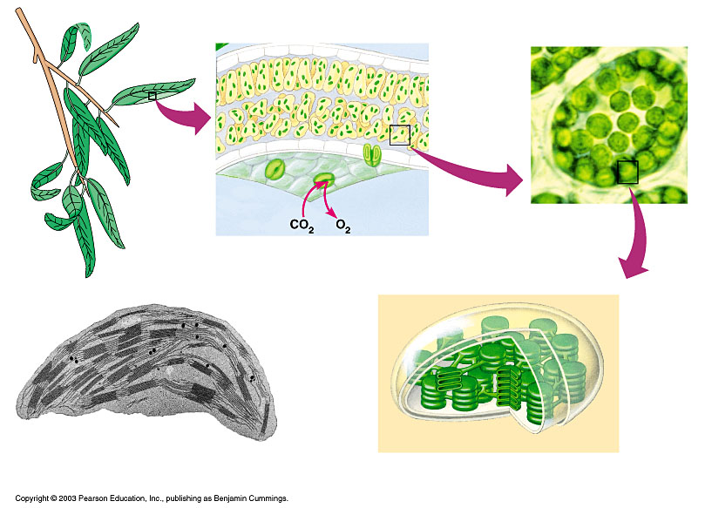
Chloroplast
LEAF CROSS SECTION
MESOPHYLL CELL
LEAF
Mesophyll
CHLOROPLAST
Intermembrane space
Outer
membrane
Granum
Inner
membrane
Grana
Stroma
Thylakoid
compartment
Stroma
Thylakoid

Slide 21
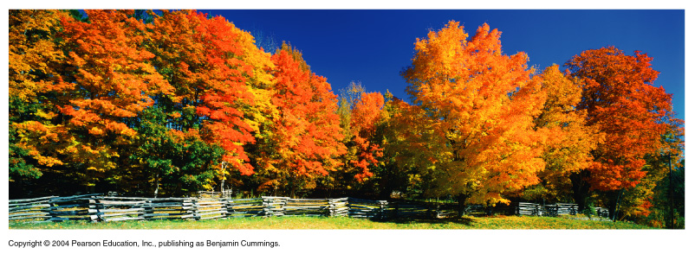
Chloroplast Pigments
Chloroplasts contain several pigments
  Chlorophyll a
  Chlorophyll b
  Carotenoids
  Xanthophyll

Slide 22
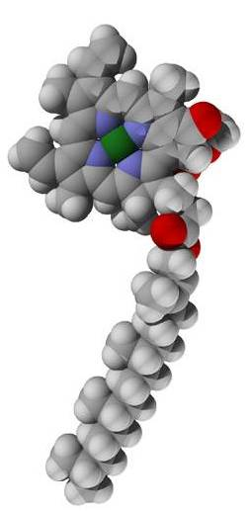
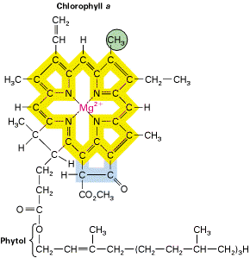
Chlorophyll a & b
Chl a has a methyl group
Chl b has a carbonyl group
Porphyrin ring
delocalized e⁻

Slide 23
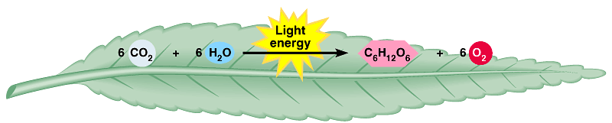
AN OVERVIEW OF PHOTOSYNTHESIS
Carbon
dioxide
Water
Glucose
Oxygen
gas
PHOTOSYNTHESIS

Slide 24
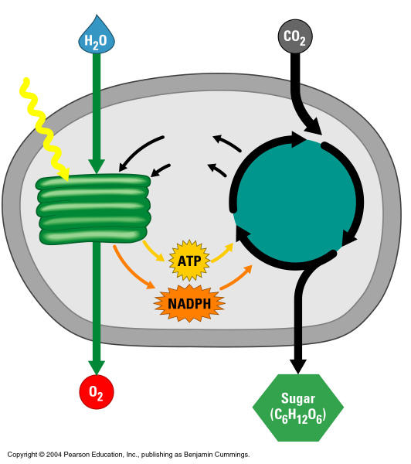
AN OVERVIEW OF PHOTOSYNTHESIS
Light dependent reaction
Light Independent reaction
Light
Chloroplast
NADP⁺
ADP
+ P
Calvin
cycle
Light
reactions

Slide 25
AN OVERVIEW OF PHOTOSYNTHESIS
Light dependent reaction (key points):
  Solar energy is converted to chemical energy
  Produces ATP & NADPH
Light
Chloroplast
NADP⁺
ADP
+ P
Calvin
cycle
Light
reactions

Slide 26
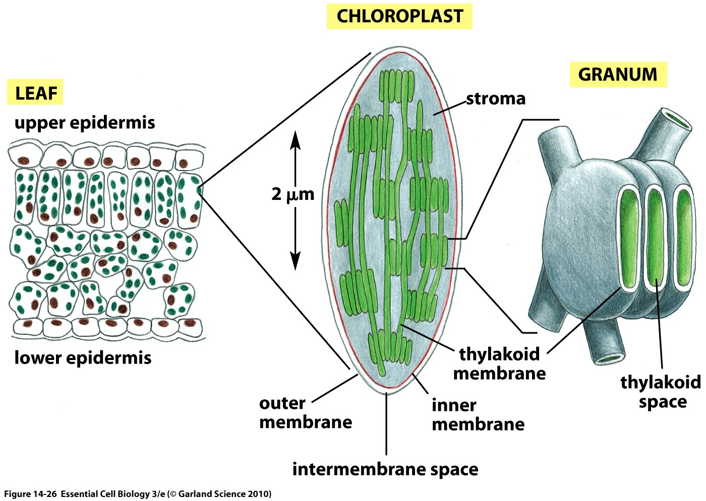
Steps of Photosynthesis
“THE LIGHT REACTION”
  Location - In the thylakoid membrane of chloroplasts.

Slide 27
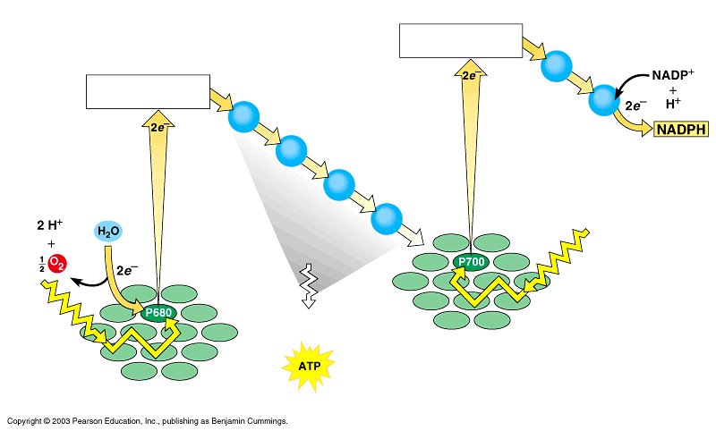
Steps of Photosynthesis
“THE LIGHT REACTION”
  1. Light hits reaction centers (photosystems) of chlorophyll, found in chloroplasts
Primary
electron acceptor
Electron transport
Primary
electron acceptor
Electron transport chain
Photons
Energy for
synthesis of
PHOTOSYSTEM I
PHOTOSYSTEM II
by chemiosmosis

Slide 28
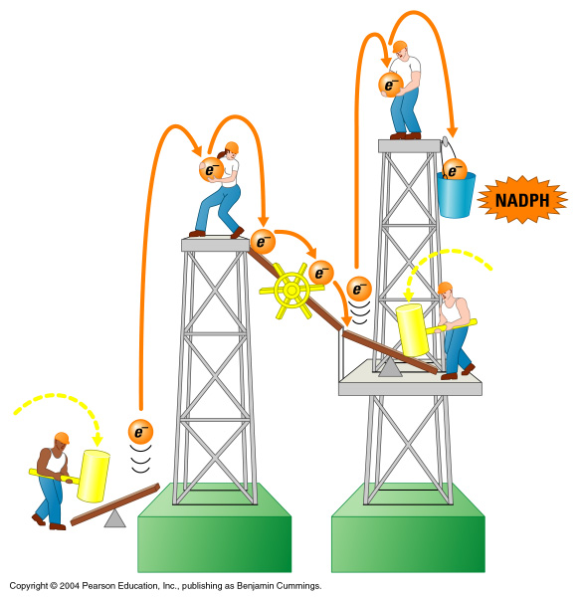
“THE LIGHT REACTION”
  Light hits reaction centers of chlorophyll, found in chloroplasts
Photon
ATP
mill
Photon
Water-splitting
photosystem
NADPH-producing
photosystem

Slide 29
Steps of Photosynthesis
“THE LIGHT REACTION”
  In the thylakoid membrane of chloroplasts.
  1. Light hits reaction centers of chlorophyll, found in chloroplasts
  2. Excited electrons from photosystems causes water to break apart into hydrogen and oxygen.

Slide 30
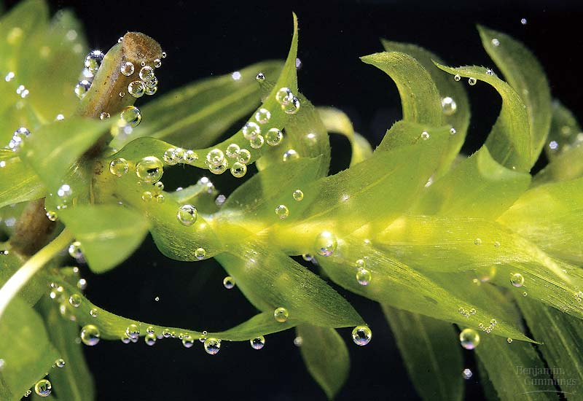
Steps of Photosynthesis
“THE LIGHT REACTION”
  1. Light hits reaction centers of chlorophyll, found in chloroplasts
  2. Excited electrons from photosystems causes water to break apart.
    Oxygen is released into air
    2 H₂O → 4 H⁺ + 4e⁻ + O₂

Slide 31
Steps of Photosynthesis
“THE LIGHT REACTION”
  In the thylakoid membrane of chloroplasts.
  1. Light hits reaction centers of chlorophyll, found in chloroplasts
  2. Excited electrons from photosystems causes water to break apart.
    Oxygen is released into air
  3. Hydrogen from water makes ATP and NADPH (energy).

Slide 32
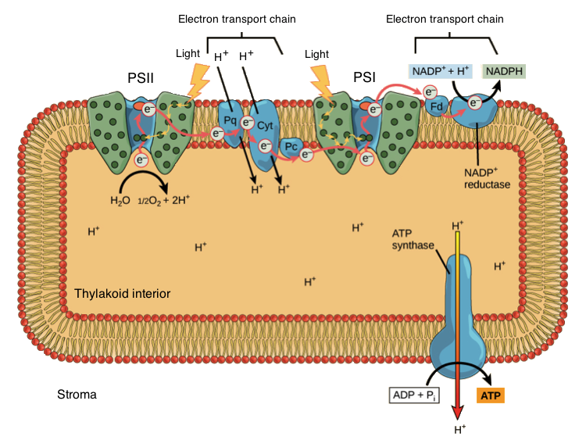
Steps of Photosynthesis

Slide 33
Steps of Photosynthesis
“THE LIGHT REACTION”
  Light hits reaction centers of chlorophyll, found in chloroplasts
  Chlorophyll vibrates and causes water to break apart.
  Oxygen is released into air
  ATP and NADPH are produced.
    Needed for the 2nd phase of photosynthesis.

Slide 34
Steps of Photosynthesis
“THE LIGHT REACTION”
  In the thylakoid membrane of the chloroplast.
  Produces ATP and NADPH.

Slide 35
AN OVERVIEW OF PHOTOSYNTHESIS
Light dependent reaction
Light Independent reaction
Light
Chloroplast
NADP⁺
ADP
+ P
Calvin
cycle
Light
reactions

Slide 36
Steps of Photosynthesis
Light independent reaction:
  A.K.A. The Calvin Cycle
  Turns carbon dioxide to glucose
  Uses the NADPH and ATP from the Light Dependent Reaction.

Slide 37
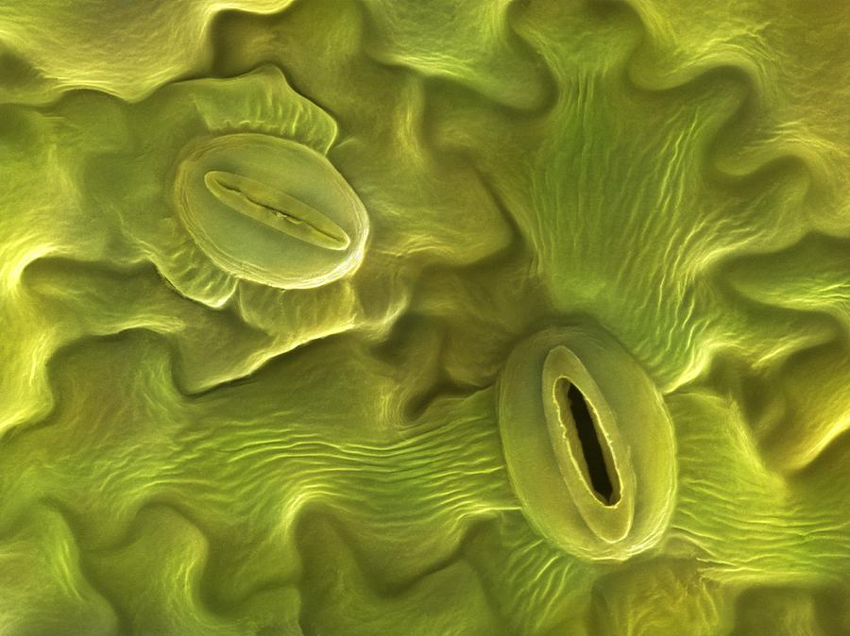
Steps of Photosynthesis
Light Independent Reacion
  1. CO₂ enters the leaf through the stomata.

Slide 38
Steps of Photosynthesis
Light Independent Reacion
  1. CO₂ enters the leaf through the stomata.
  2. CO₂ goes to the stroma of the chloroplast.

Slide 39
Steps of Photosynthesis
Light Independent Reacion
  The DARK Reactions= Calvin Cycle
  1. CO₂ enters the leaf through the stomata.
  2. CO₂ goes to the stroma of the chloroplast.
  3. CO₂ is “fixed” – incorporated into 3 C sugars.

Slide 40
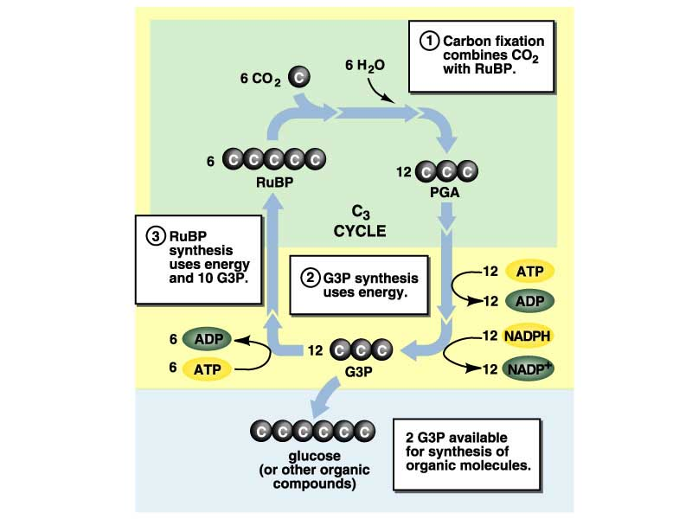
Steps of Photosynthesis

Slide 41
Steps of Photosynthesis
Light Independent Reacion
  1. CO₂ enters the leaf through the stomata.
  2. CO₂ goes to the stroma of the chloroplast.
  3. CO₂ is “fixed” – incorporated into 3 C sugars.
    ATP and NAPDH provide the energy for this.

Slide 42
Steps of Photosynthesis
Light Independent Reacion
  The DARK Reactions= Calvin Cycle
  1. CO₂ enters the leaf through the stomata.
  2. CO₂ goes to the stroma of the chloroplast.
  3. CO₂ is “fixed” – incorporated into 3 C sugars.
    ATP and NAPDH provide the energy for this.
    Uses enzymes (e.g, rubisco)

Slide 43
Steps of Photosynthesis
Light Independent Reacion
  The DARK Reactions= Calvin Cycle
  1. CO₂ enters the leaf through the stomata.
  2. CO₂ goes to the stroma of the chloroplast.
  3. CO₂ is “fixed” – incorporated into 3 C sugars.
    ATP and NAPDH provide the energy for this.
    Uses enzymes (e.g, rubisco)
  4. Glucose is produced.

Slide 44
Animation is of the Calvin Cycle Note what happens to the carbon dioxide and what the end product is.
Second animation of the Calvin Cycle is very clear and even does the molecular bookkeeping for you.

Slide 45
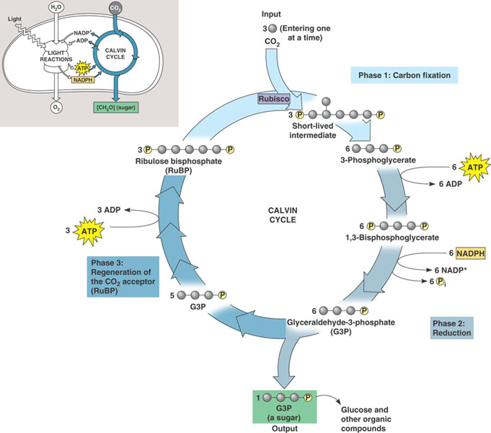
Light Independent Reactions aka Calvin Cycle
Carbon from CO₂ is
converted to glucose
(ATP and NADPH
drive the reduction of CO2 to C₆H₁₂O₆.)

Slide 46
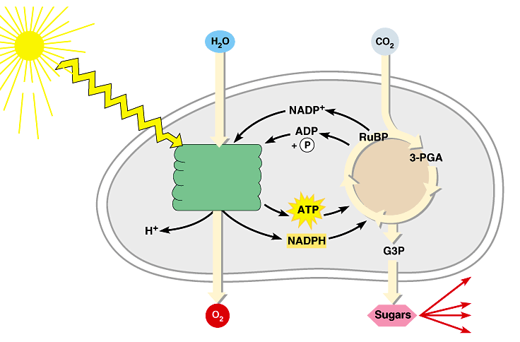
Review: Photosynthesis uses light energy to make food molecules
Chloroplast
Light
Photosystem II
Electron transport chains Photosystem I
CALVIN CYCLE
Stroma
Electrons
Cellular respiration
Cellulose
Starch
Other organic compounds
LIGHT REACTIONS
CALVIN CYCLE

Slide 47
C4 Photosynthesis
Certain plants have developed ways to limit the amount of photorespiration
  C4 Pathway*
  CAM Pathway*
  * Both convert CO₂ into a 4 carbon intermediate → C4 Photosynthesis

Slide 48
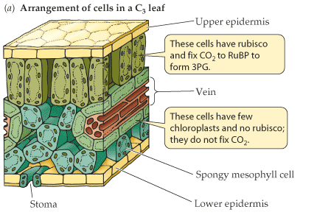
Leaf Anatomy
In C3 plants (those that do C3 photosynthesis), all processes occur in the mesophyll cells.
Mesophyll cells
Bundle sheath cells
Image taken without permission from http://bcs.whfreeman.com/thelifewire|

Slide 49
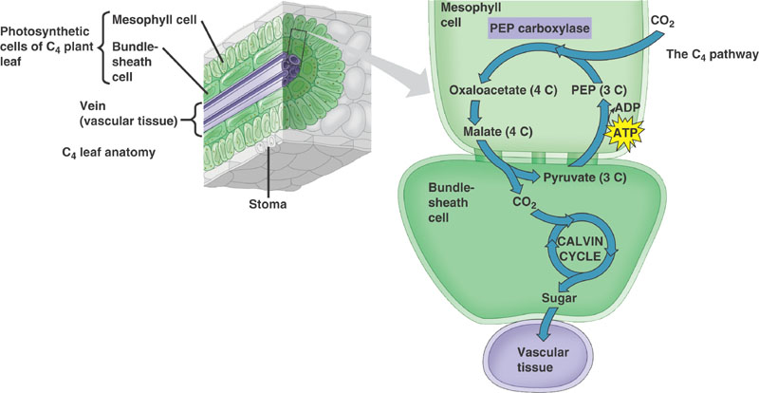
C4 Pathway
In C4 plants photosynthesis occurs in both the mesophyll and the bundle sheath cells.
Notes:
Affinity of PEP Carboxylase for CO2 is much higher than its affinity for O2.

Slide 50
C4 Pathway
CO₂ is fixed into a 4-carbon intermediate
Has an extra enzyme– PEP Carboxylase that initially traps CO₂ instead of Rubisco– makes a 4 carbon intermediate

Slide 51
C4 Pathway
The 4 carbon intermediate is “smuggled” into the bundle sheath cell
The bundle sheath cell is not very permeable to CO₂
CO₂ is released from the 4C malate → goes through the Calvin Cycle
C3 Pathway

Slide 52
How does the C4 Pathway limit photorespiration?
Bundle sheath cells are far from the surface– less O₂ access
PEP Carboxylase doesn’t have an affinity for O₂ → allows plant to collect a lot of CO₂ and concentrate it in the bundle sheath cells (where Rubisco is)

Slide 53
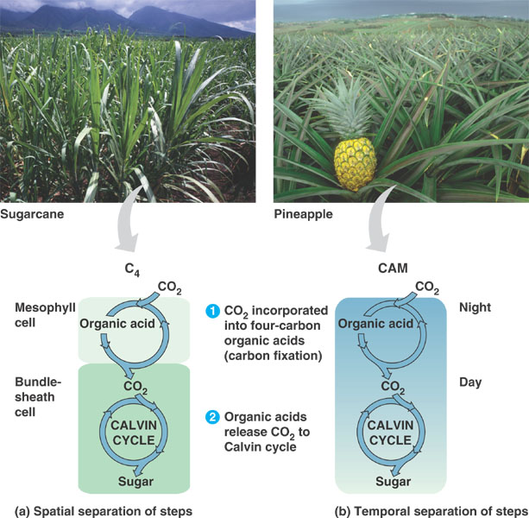
CAM Pathway
Fix CO₂ at night and store as a 4 carbon molecule
Keep stomates closed during day to prevent water loss
Same general process as C4 Pathway

Slide 54
How does the CAM Pathway limit photorespiration?
Collects CO₂ at night so that it can be more concentrated during the day
Plant can still do the calvin cycle during the day without losing water

Slide 55
Summary of C4 Photosynthesis
C4 Pathway
  Separates by space (different locations)
CAM Pathway
  Separates reactions by time (night versus day)

