Slide 1
Garden Design
Moretz, 2017/2018

Slide 2
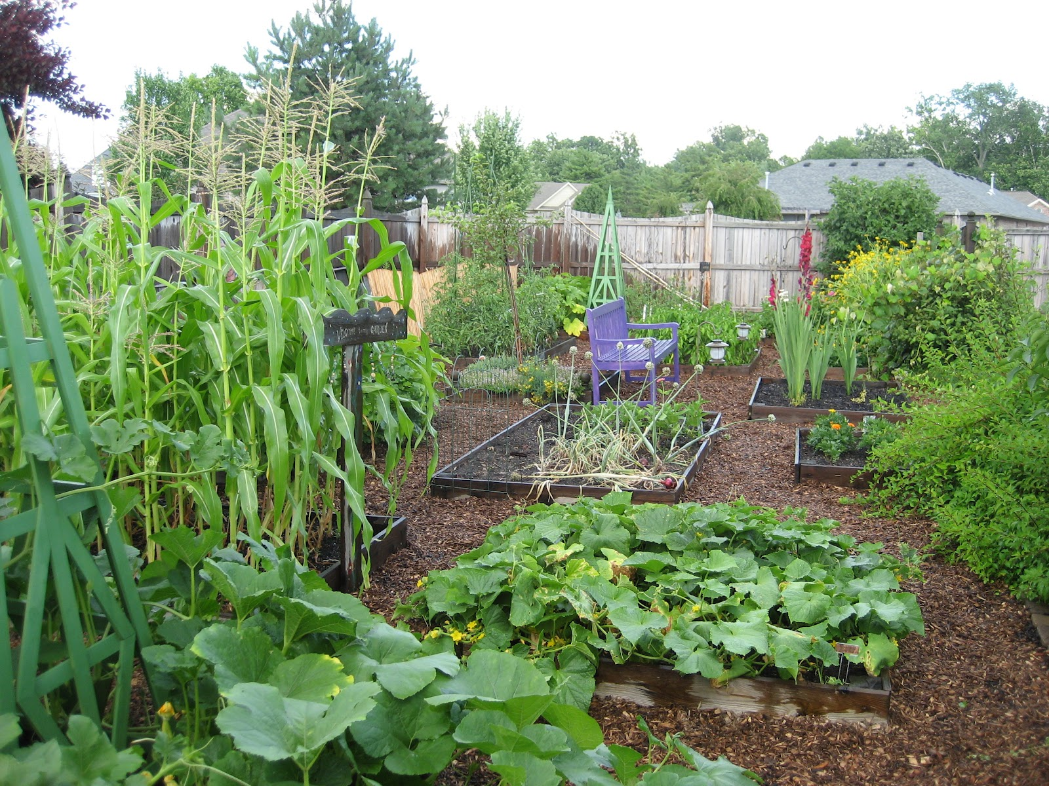

Slide 3
My Dream Garden…
Observations – assets & obstacles
Design & Sketch
Revisions
Feedback
Consensus
Model
Construct

Slide 4
Garden Design Gallery Walk
In library.
Designs on tables spread out through room.
Present for half of the time; offer feedback for the other half of the time
Record feedback in journal.
Note design elements that you see that you would like to include in the final product.

Slide 5
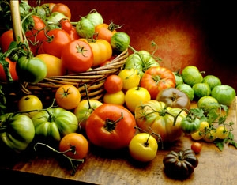
Heirloom Tomato “lab”
Obtain a tomato wedge.
Remove seeds. Place seeds on paper towel on tray
Eat a section of a tomato ☺

Slide 6
Building a Consensus
Raised beds – where???
Flower garden
Tree
Fruit Bushes
Picnic Tables
Bees
Bird feeders
Compost
Rain barrels
Chickens

Slide 7
Construction Steps: Short-Term
Research fall plants – Maria, Kaatje, Bri, Kayla, Vicente
Clean existing beds – Miles, Heidi, Loren, Anthony, Josue
Plant fall plants – Bri, Kayla, Rileigh, Andy, Chris, Jamin, Josue, Osbaldo
Research perennial pollinator-attracting flowers – Ryan, Aaron, Kaylyn, Tristan, Caden
Determine location for raised beds & perennials – Evan, Laycee, Chase, Ronan
Seed perennials – Isaac, Chris, Loren, Ahitza, Xavier, Natalie
Create garden master blueprint – Monro, Reese, Sawyer, Andreas

Slide 8
Construction Steps: Long-Term
Determine raised bed locations – Chase, Laycee, Maria, Evan
Locate sprinkler heads
Determine dimensions and orientations of beds
Design raised beds
Lumber search
Build beds – Chase, Miles, Tristan
Fruit bushes - Jamin
Soil day – Sat., Sept 16th

Slide 9
Construction Steps: Longer-Term
Irrigation
Compost
Rain barrels - Ryan
Greenhouse – Laycee, Bri, Miles
Hydroponics – Isaac & Evan
Bees - Ronan
Chickens/Goats – Laycee, Ronan, Kaatje
Shade structure – Kaatje
Bird feeders – Evan, Anthony
Art structures – Miles, Kaydin, Tristan

