Slide 1
Invasive Species
Moretz
Biology, 2013/2014

Slide 2
In the News…
http://www.npr.org/blogs/thesalt/2012/08/31/160394513/battle-over-michigans-new-swine-rules-goes-hog-wild
http://www.npr.org/templates/story/story.php?storyId=6129944
http://www.npr.org/2013/07/28/206377797/the-rise-of-bloodsucking-insects-you-cant-just-swat-away

Slide 3
What is an invasive species?
“… an alien (or non-native) species whose introduction does, or is likely to cause economic or environmental harm or harm to human health.”
as defined by the federal government
Most non-native species are NOT invasive.
Can include animals, plants, fungi, bacteria, and others.
50,000 non-native species in U.S.; 4,300 invasive species

Slide 4
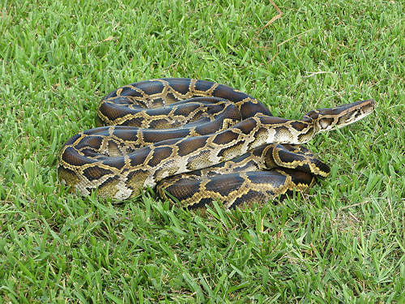
How are invasive Species spread?
Most invasive species are distributed through human activity.
Introduced intentionally:
Pet trade
Landscaping
Biological control

Slide 5
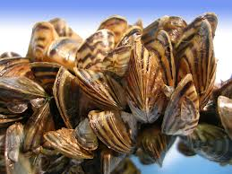
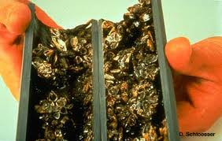
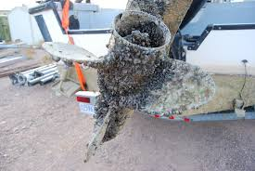
How are invasive species spread?
Introduced accidentally:
Attached to ships
Transported with produce
Soil in shoes and tires
Escape from fish farms
Pathogens spread from non-native to native species

Slide 6
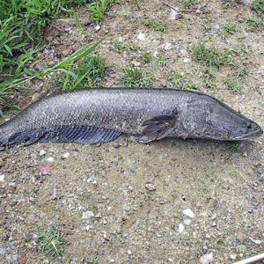
What are the Characteristics of invasive Species?
Tolerant of a variety of habitats
Grow rapidly
Reproduce rapidly
Outcompete native species for resources
No natural predators

Slide 7
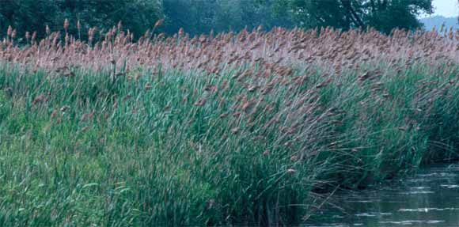
What Environmental effects Can Invasive Species Have?
Displace native species.
Reduce native wildlife habitat.
Reduce forest health and productivity.
Alter ecosystem processes.
Degrade recreation areas.
Spread pathogens

Slide 8
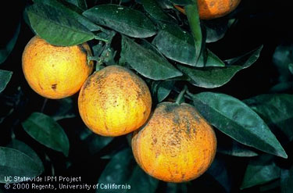
What Economic effects Can Invasive Species Have?
$1.4 TRILLION per year, globally
$137 BILLION per year, U.S.
$74 BILLION from SIX invasive species

Slide 9
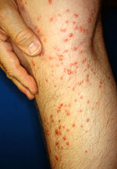
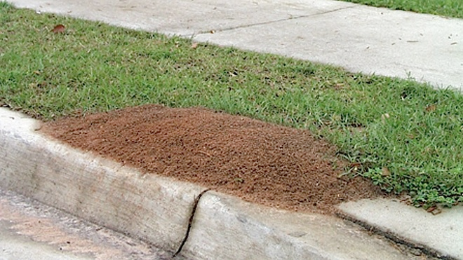
What Health effects Can Invasive Species Have?
Spread disease
Decrease available water supplies
Decrease available food supplies
Skin irritation

Slide 10
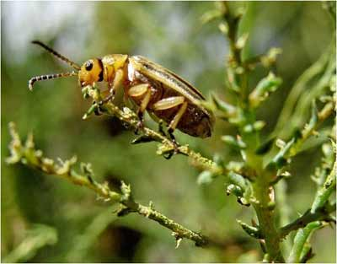
How are Invasive species Controlled?
Biological control – introduction of the species natural enemy to kill it
Chemical control – use of pesticides to kill species
Mechanical control – physically removing or stopping the spread of species.
Cultural management – change of the species habitat to decrease its spread.

Slide 11
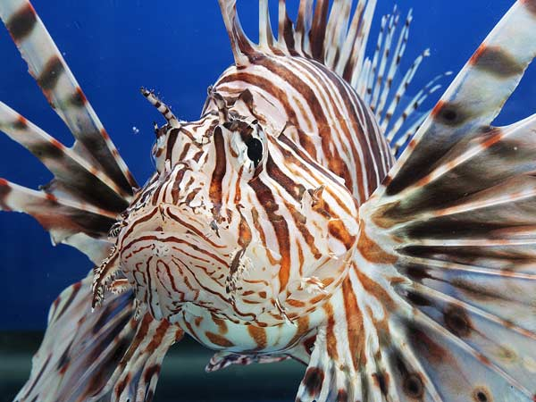
How can individuals decrease the spread of invasive species?
Clean outdoor gear
Don’t release pets or aquarium wild
Clean and drain boats at site of use
Don’t plant invasive plants for landscaping
Clean soil off shoes and vehicles at site of use

Slide 12
What invasives are in utah?
Aquatics: http://nas.er.usgs.gov/queries/SpeciesList.aspx?Group=&State=UT&Sortby=%5BGroup%5D,Genus,Species,SubSpecies&submit2=Submit
Noxious Wees:http://plants.usda.gov/java/noxious?rptType=State&statefips=49

Slide 13
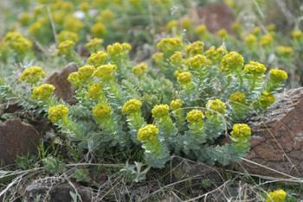
What is Myrtle Spurge?

